Slide 1
VLSI Final Project RISC-V Pipelined CPU
Member: 張根齊、林軒宇、陳正崙、林伯璨、吳宜哲、林琮偉

Slide 2
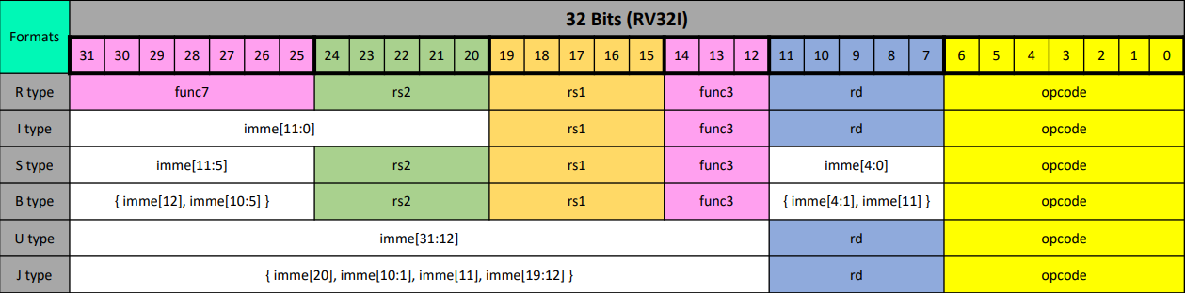
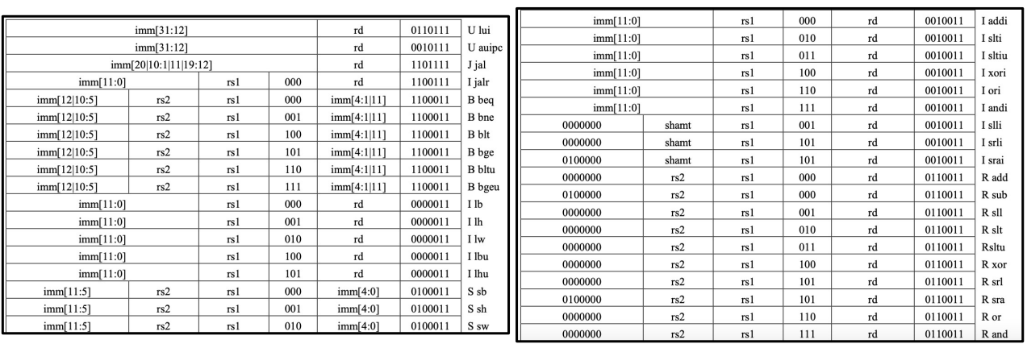
RISC-V 指令集架構

Slide 3
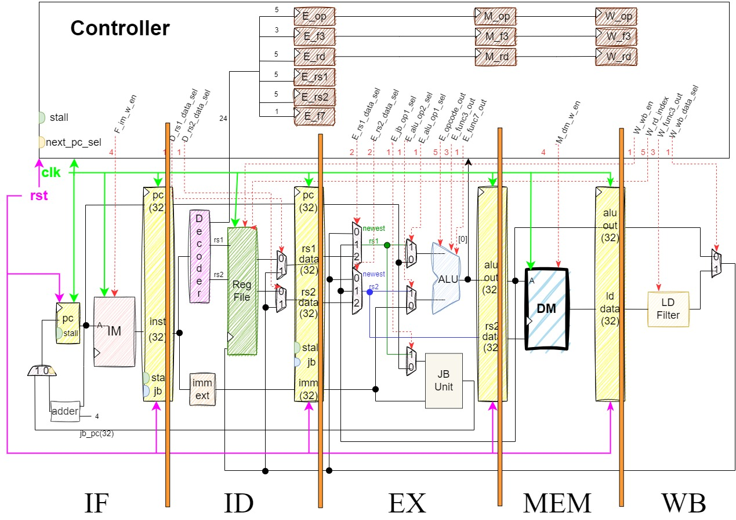
Structure Diagram of RISC-V Pipeline CPU

Slide 4
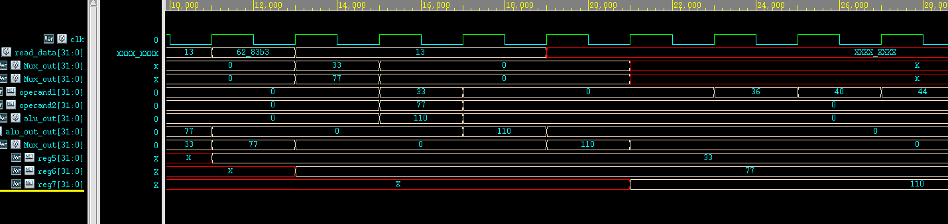
R-Type (add rd, rs1, rs2)
rd = rs1 + rs2
IF
ID
EX
MEM
WB
add x7, x5, x6

Slide 5
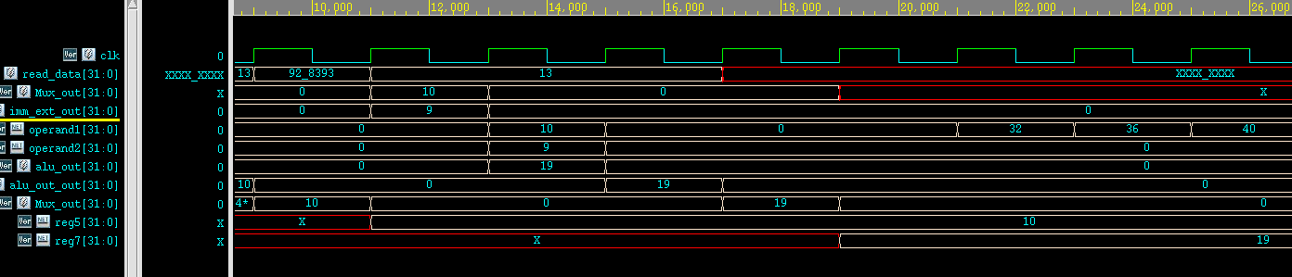
I-Type (addi rd, rs1, imm)
addi x7, x5, 9
rd = rs1 + rs2
EX
MEM
WB
IF
ID
EX
I-Type Dataflow

Slide 6
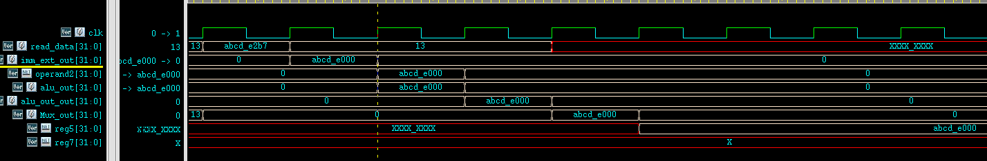
U-Type (lui rd, imm)
lui x5, 0xabcde
MEM
WB
IF
ID
EX
U-Type Dataflow

Slide 7
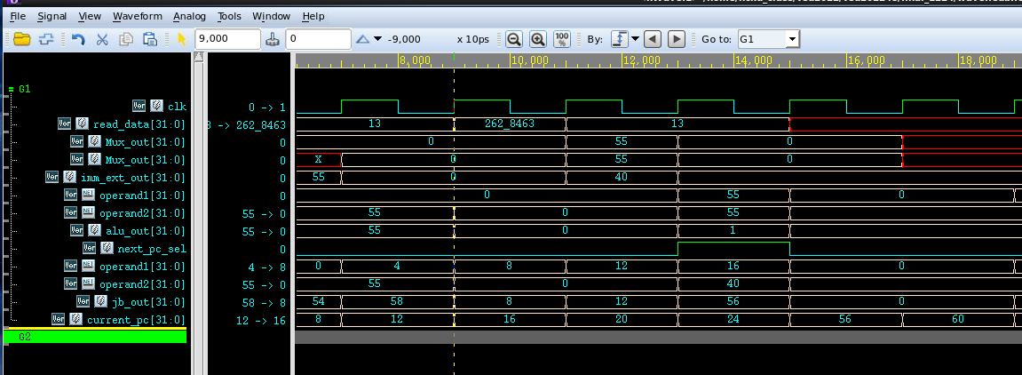
B-Type (beq rs1,rs2,imm)
beq x5, x6, 40
rs1 = rs2，要跳轉
計算跳轉地址
ID
IF
EX

Slide 8
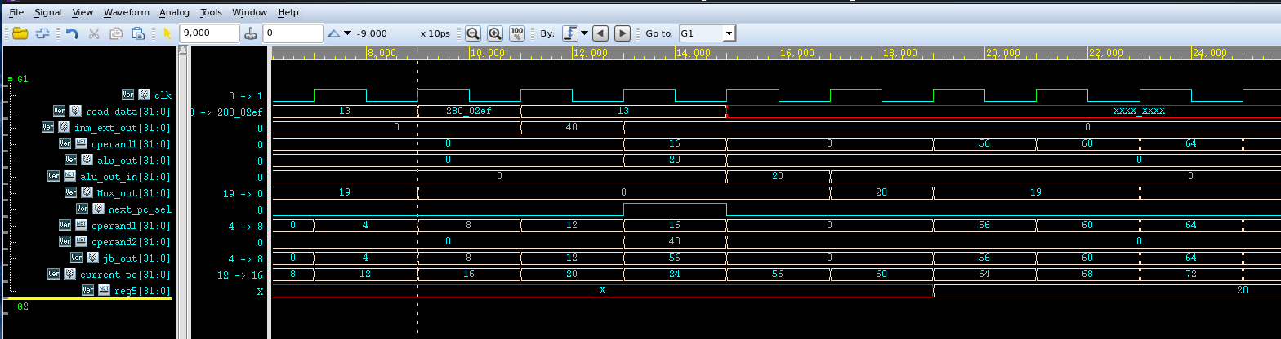
J-Type (jal rd,imm)
jal x5, 40
計算跳轉地址
ID
IF
EX
MEM
WB

Slide 9
Structure Hazard

Slide 10
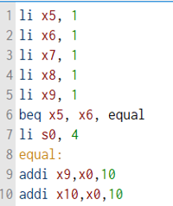
Control Hazard
Cycle | IF | ID | EX | MEM | WB
0 | li x8,1
1 | li x9, 1 | li x8,1
2 | beq x5, x6,equal | li x9, 1 | li x8,1
3 | li s0,4 | beq x5, x6,equal | li x9, 1 | li x8,1
4 | addi x9,x0,10 | li s0,4 | beq x5, x6,equal | li x9, 1 | li x8,1
5 | addi x9,x0,10 | nop | nop | beq x5, x6,equal | li x9, 1

Slide 11
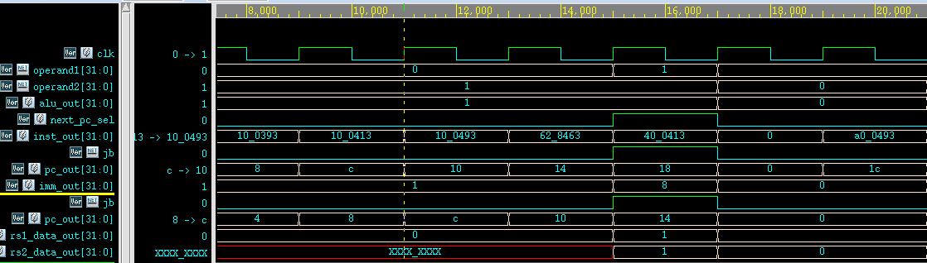
Control Hazard
條件判斷符合，Branch到指定PC
ID
EX

Slide 12
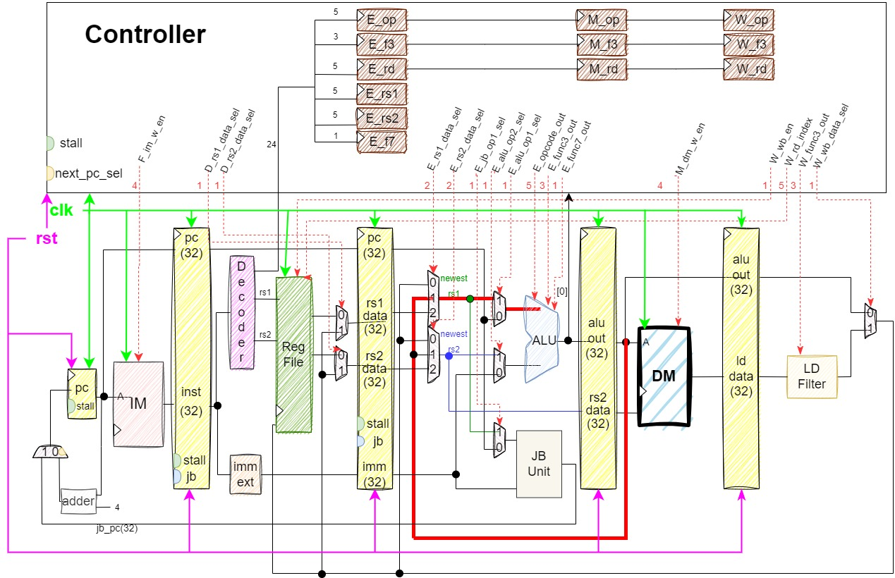
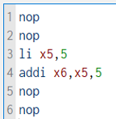
Data Hazard
addi
li

Slide 13
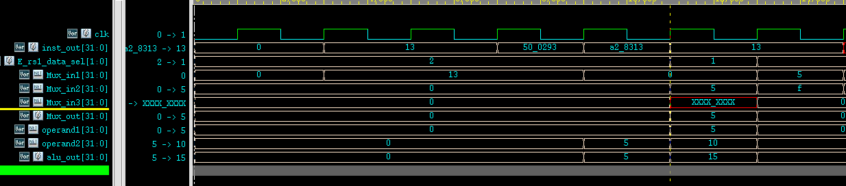
Data Hazard
Mux_sel選1
Mux_out=5

Slide 14
Extra Design
Branch Predictor, Cache, Single-Precision Floating-Point Processor, Accelerated Multiplier

Slide 15
Branch Predictor
Branch Prediction within RISC-V Pipelined CPU

Slide 16
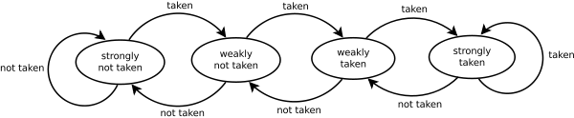
Predictor 種類
bimodal predictor
predictor state:
ST = 2‘b00 strongly taken
WT = 2'b01 weakly taken
SNT = 2'b10 strongly not taken
WNT = 2'b11 weakly not taken
Default=WNT weakly not taken

Slide 17
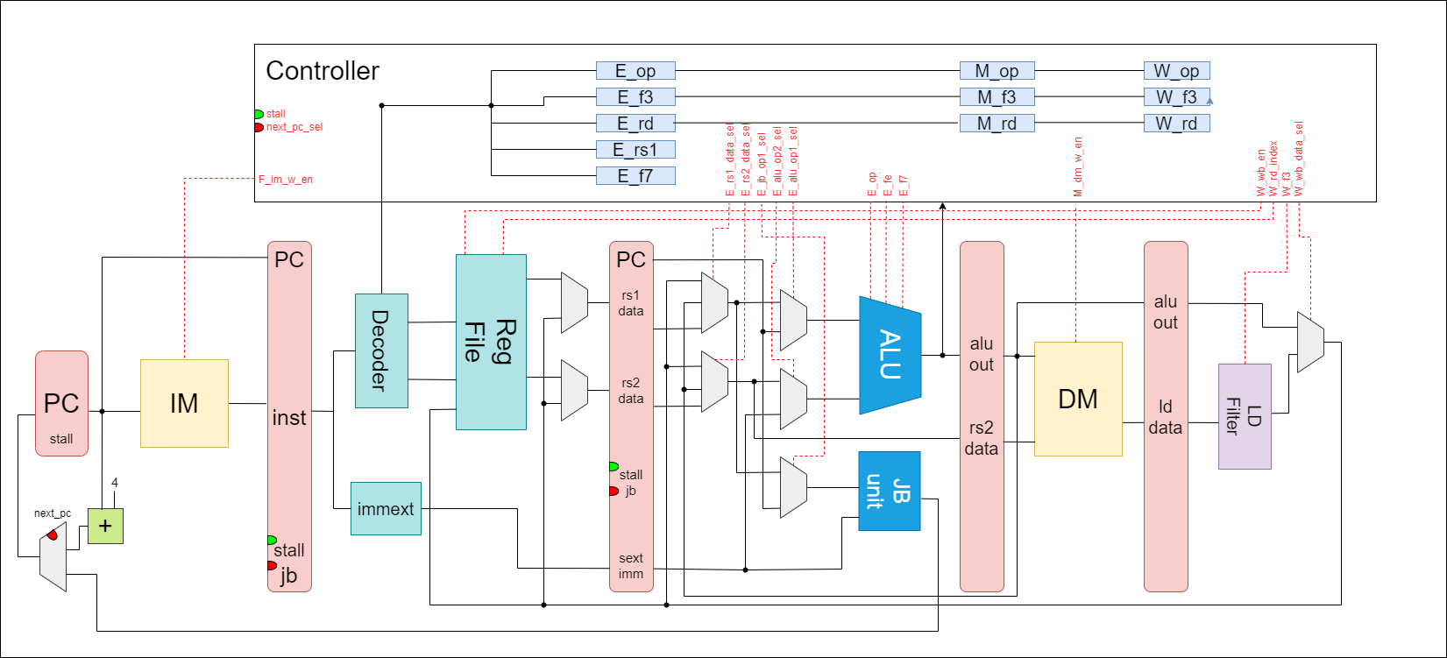
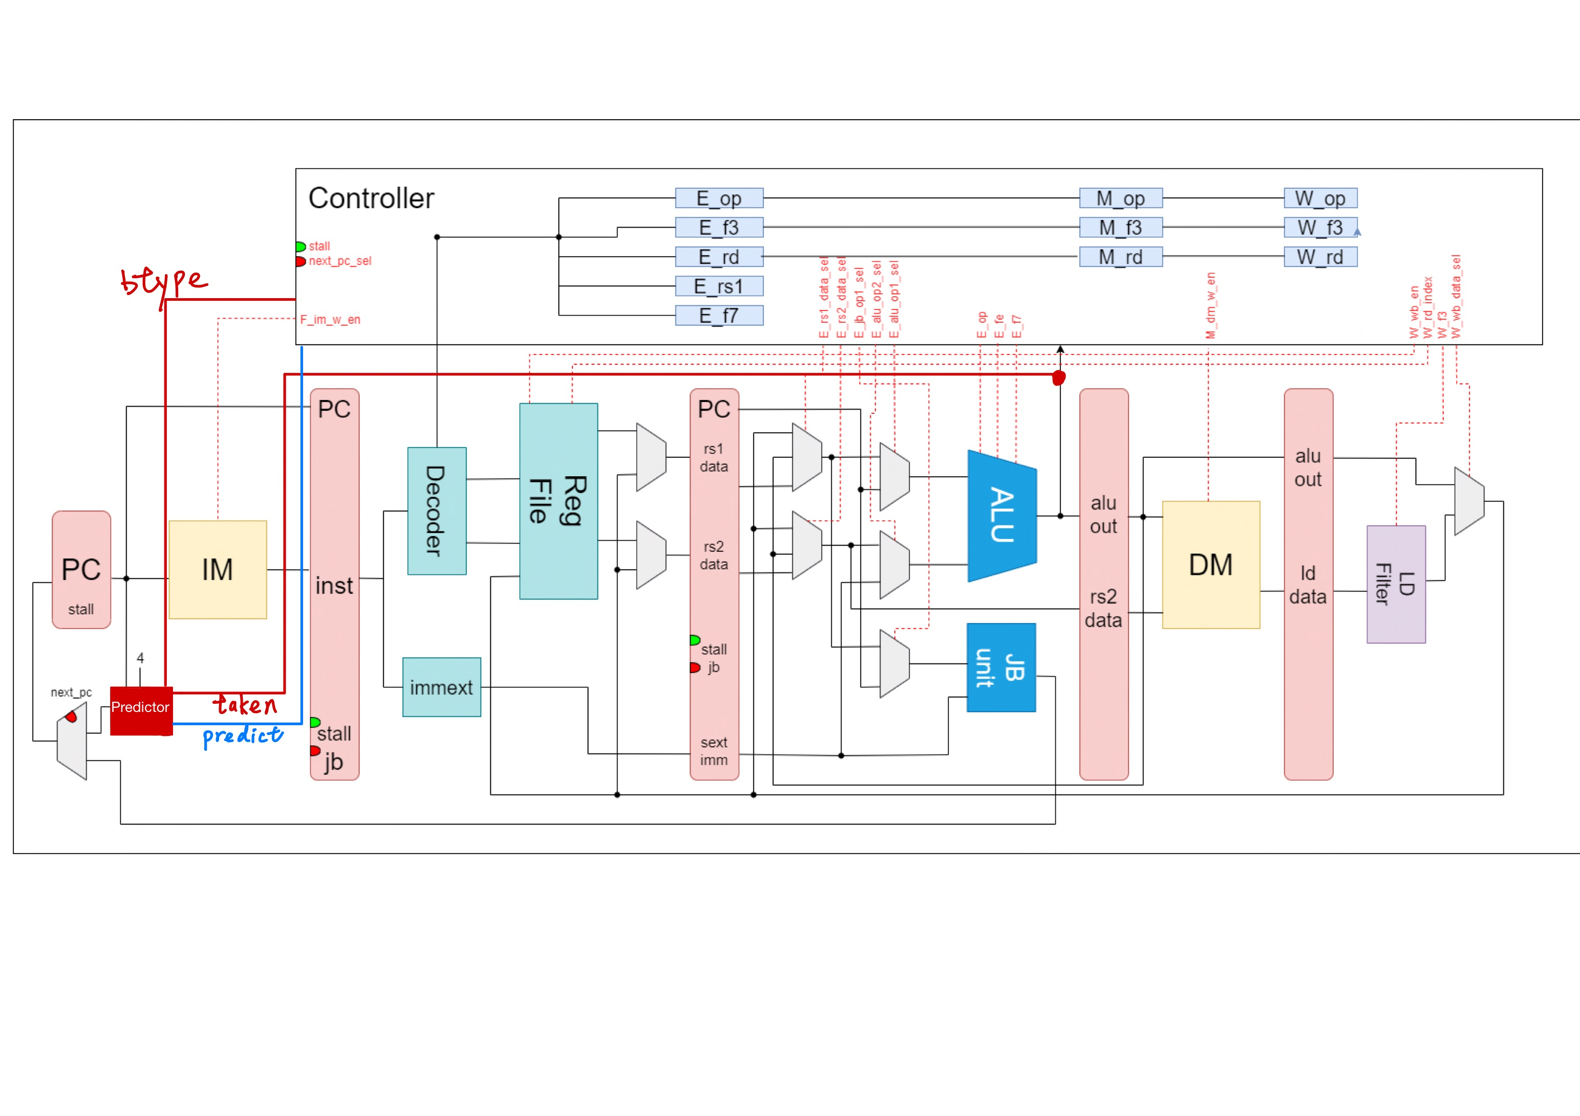
Before
After

Slide 18
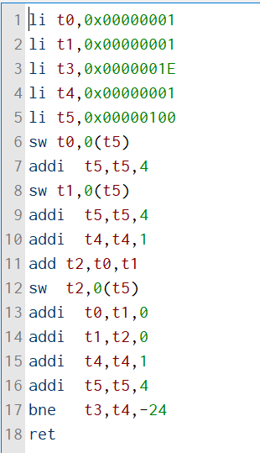
驗證結果
費氏數列

Slide 19
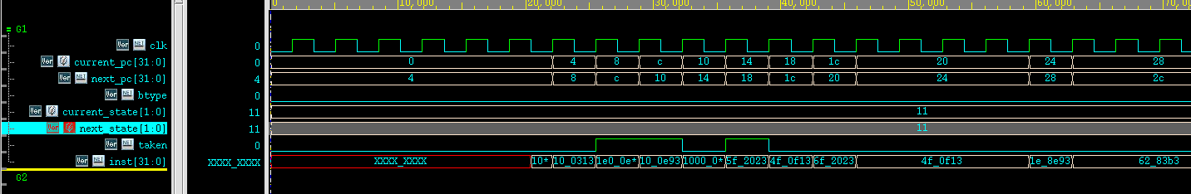
驗證結果

Slide 20
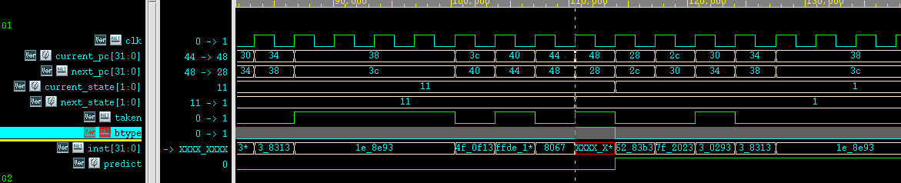
驗證結果

Slide 21
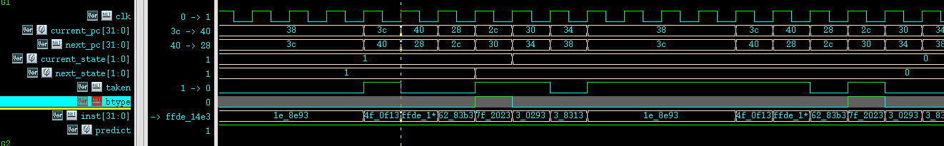
驗證結果

Slide 22
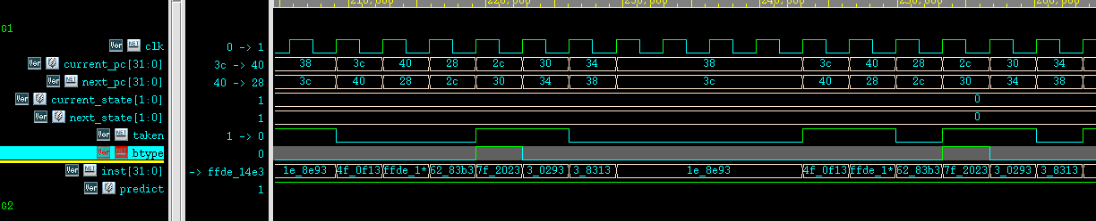
驗證結果

Slide 23
Cache
Cache Realization within RISC-V Pipelined CPU

Slide 24
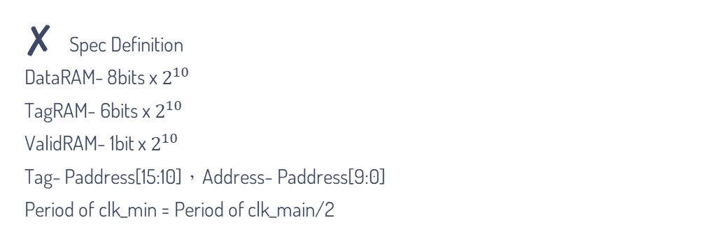
特殊設計-Cache
Spec Definition
DataRAM- 8bits x $2^{10}$
TagRAM- 6bits x $2^{10}$
ValidRAM- 1bit x $2^{10}$
Tag- Paddress[15:10]，Address- Paddress[9:0]
Period of clk_min = Period of clk_main/2
Signal Specification
LoadSelect- 透過CPU的func3判斷目前是處理BYTE, HALFWORD還是WORD
Pstrobe, SysStrobe- 表示取用Cache和SystemMemory
Pdata, SysData- Inout port, need Tristate buffer to control flow
Pready- Tell the CPU Controller that Cache has finished operation

Slide 25
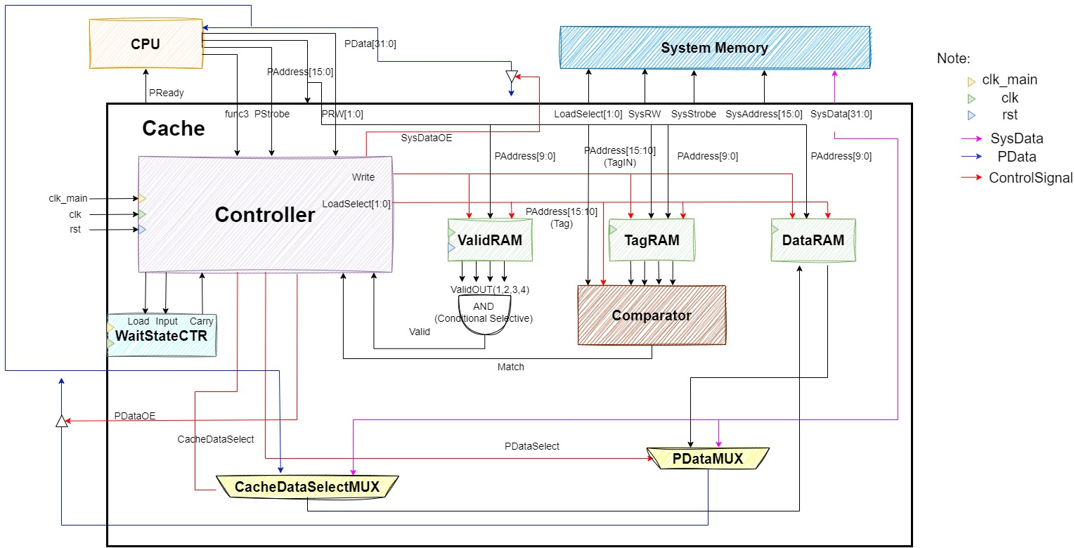
Structure Diagram of Cache

Slide 26
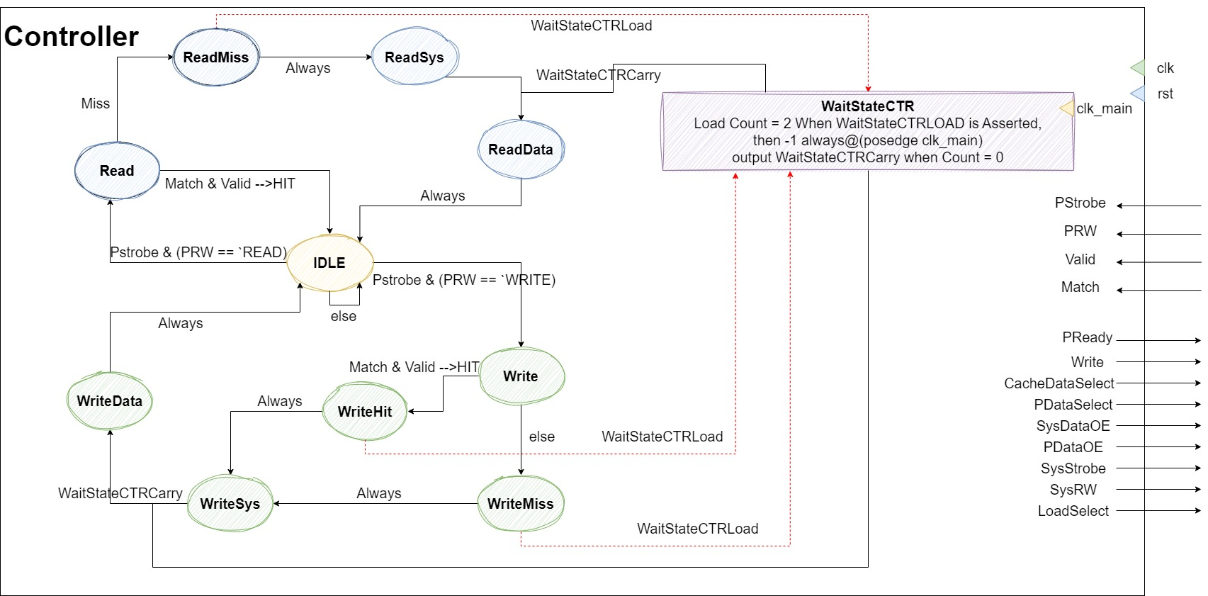
Controller & WaitStateCTR

Slide 27

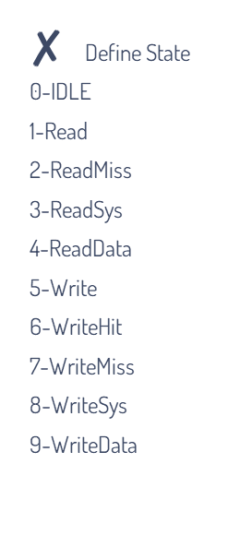
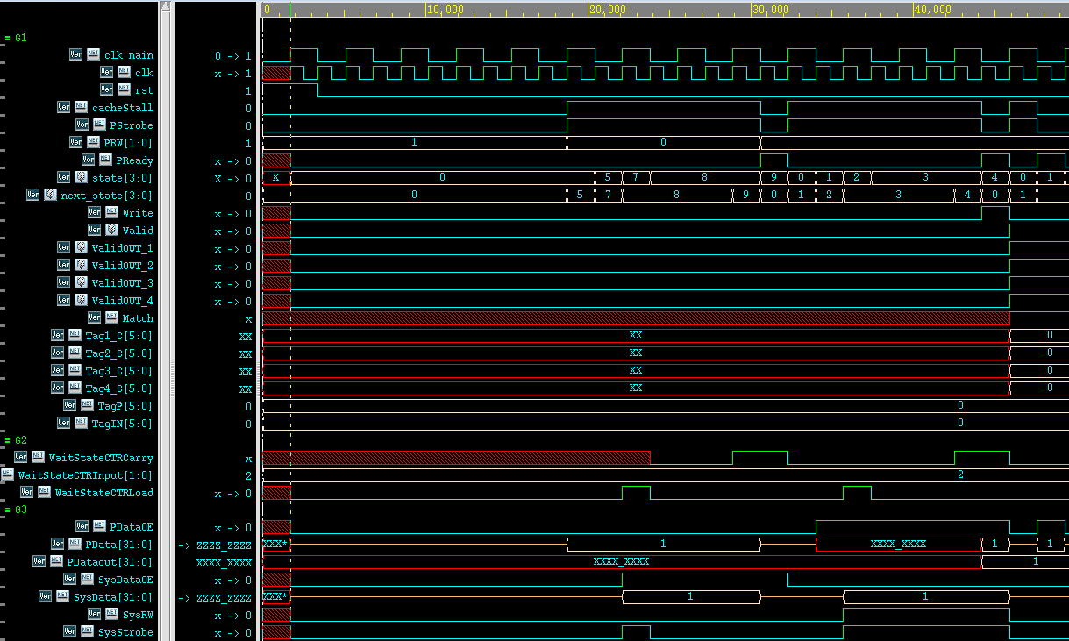
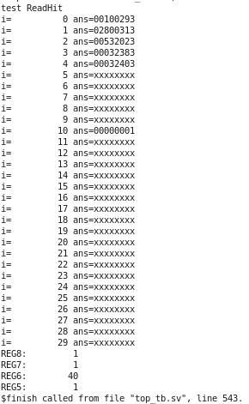
Assembly Code
addi x5 x0 1
addi x6 0 40
sw x5 0 x6
lw x7 0 x6
lw x8 0 x6

Slide 28

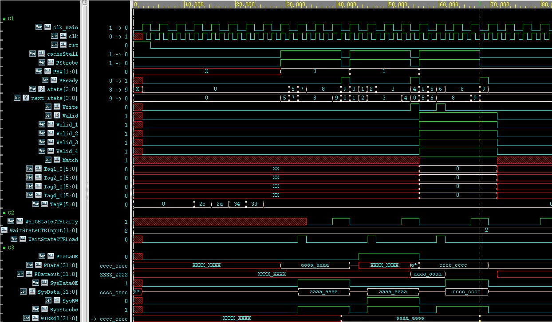
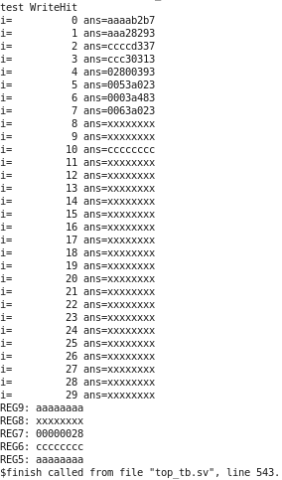
Assembly Code
lui x5 0xaaaab
addi x5 x5 -1366
lui x6 0xccccd
addi x6 x6 -820
addi x7 x0 40
sw x5 0 x7
lw x9 0 x7
sw x6 0 x7

Slide 29
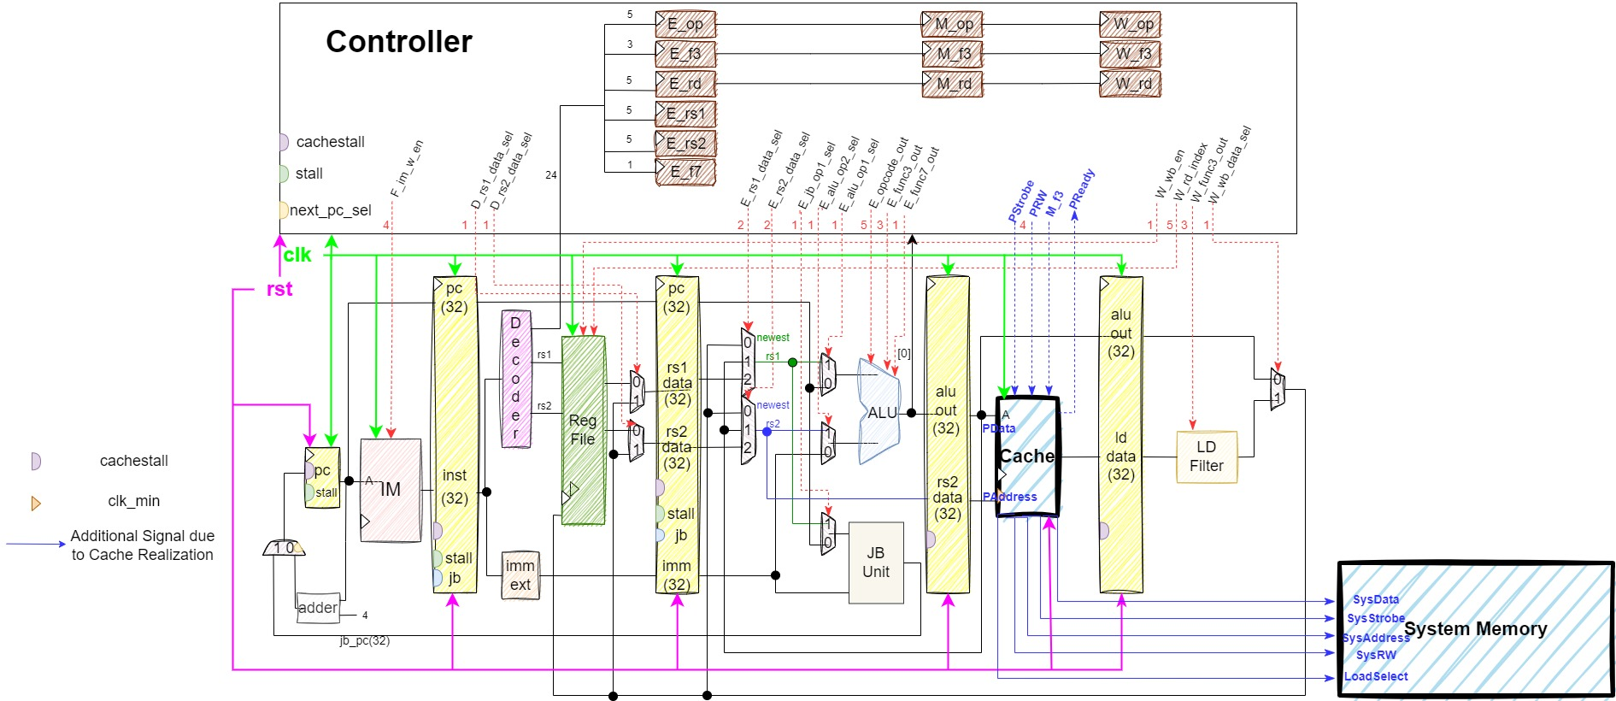
New Structure of Pipelined CPU with Cache Installed

Slide 30
Single-Precision Floating-Point Processor
Floating-point extension within RISC-V Pipelined CPU

Slide 31
Instruction set of Floating-point
FLW / FSW | FLW: 將記憶體裡的資料存進浮點數暫存器 (freg)中 FSW: 將浮點數暫存器 (freg)裡的資料存進記憶體中
FADD / FSUB | FADD: 將指定的兩個freg中的資料做相加，並存回指定的freg FSUB: 將指定的兩個freg中的資料做相減，並存回指定的freg
FMUL | 將指定的兩個freg中的資料做相乘，並存回指定的freg
FCVT.W(WU).S | 將指定freg中的資料，以無條件捨去的方式轉換為整數並存入指定的整數暫存器(reg) 中 註: U為unsigned
FCVT.S.W(WU) | 將指定 reg中的資料，以無條件捨去的方式轉換為浮點數並存入指定的 freg 中 註: U為unsigned
FMV.X.W / FMV.W.X | FMV.X.W :將指定freg中的資料，原封不動地搬入指定的 reg 中 FMV.W.X :將指定reg中的資料，原封不動地搬入指定的 freg 中

Slide 32
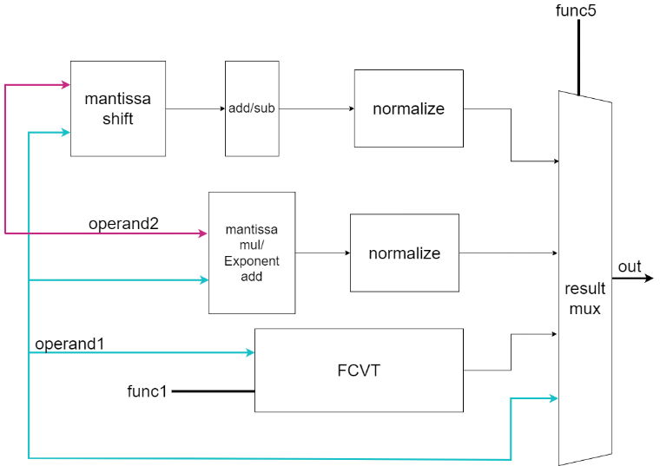

Floating-Point Unit (FPU) Structure

Slide 33
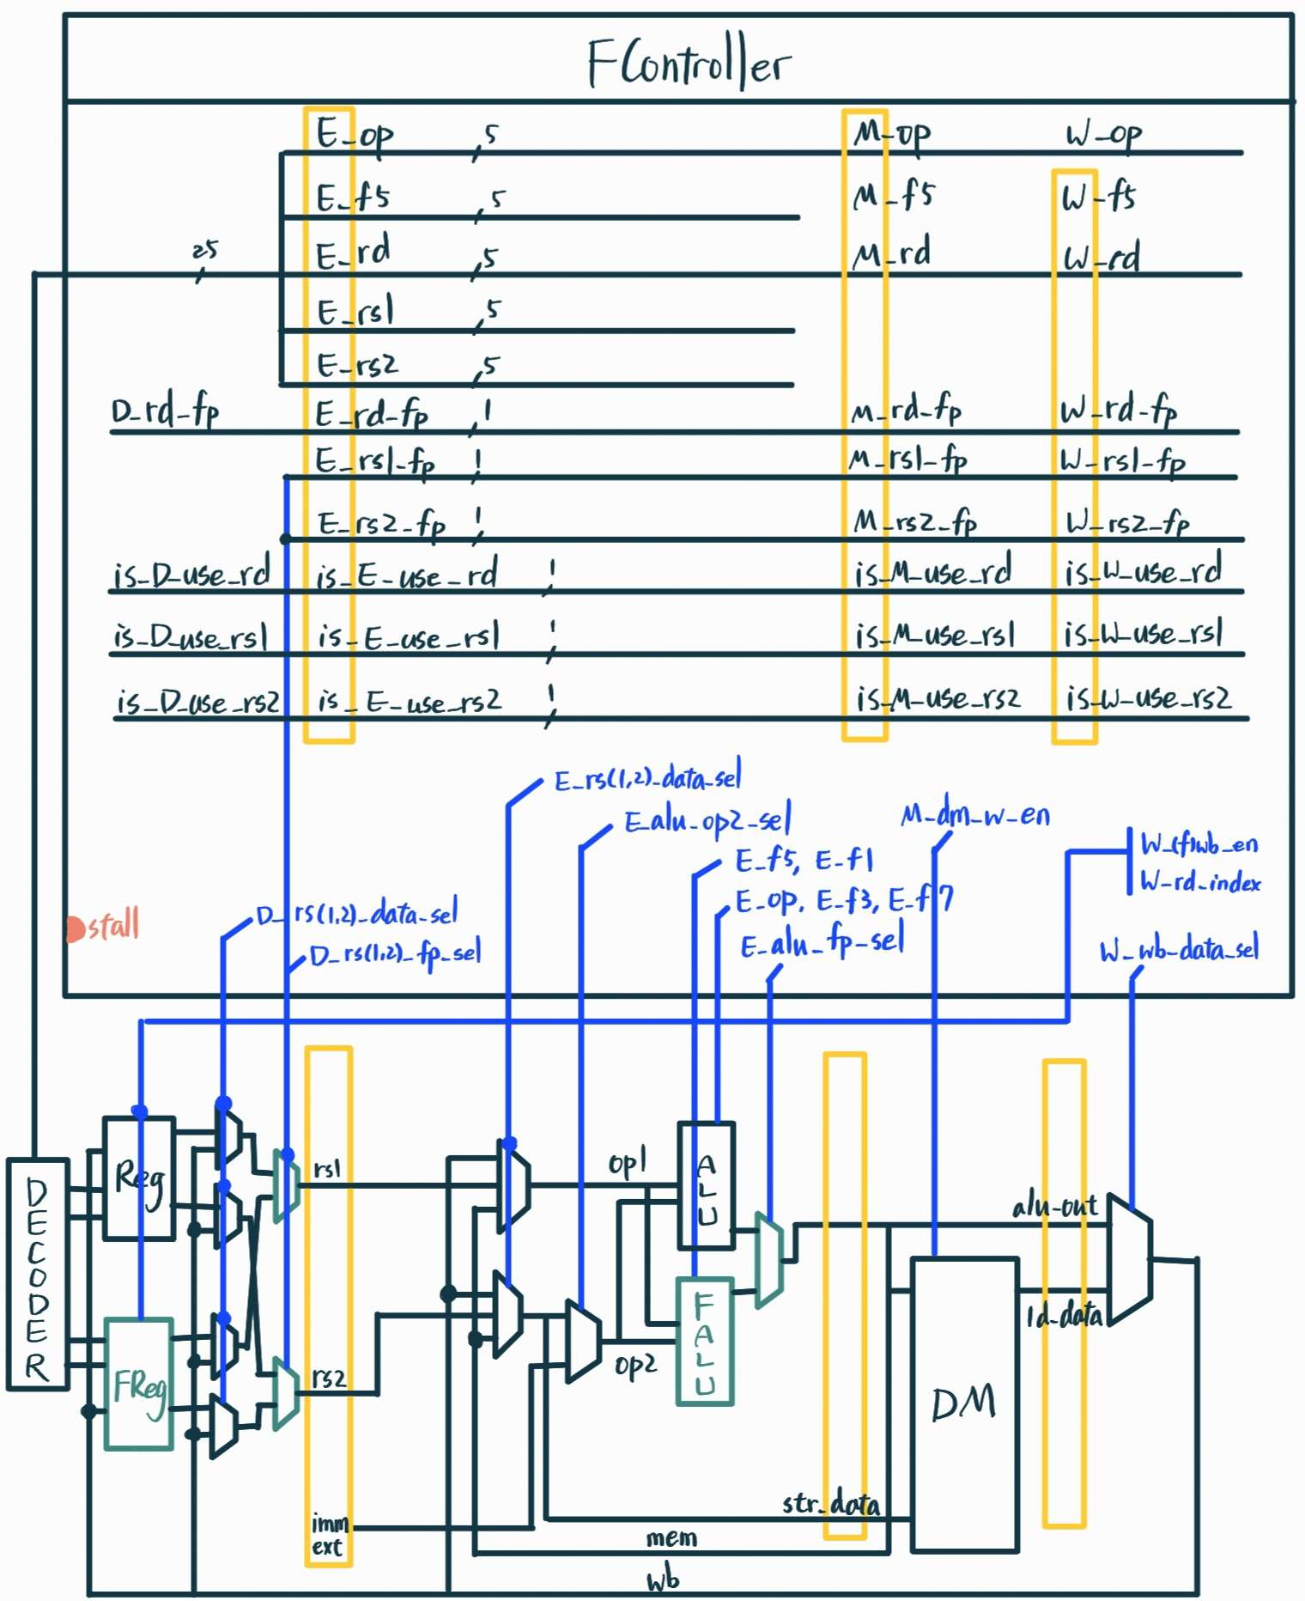
New Structure of Pipelined CPU with Single-Precision Floating-Point Processor Installed

Slide 34
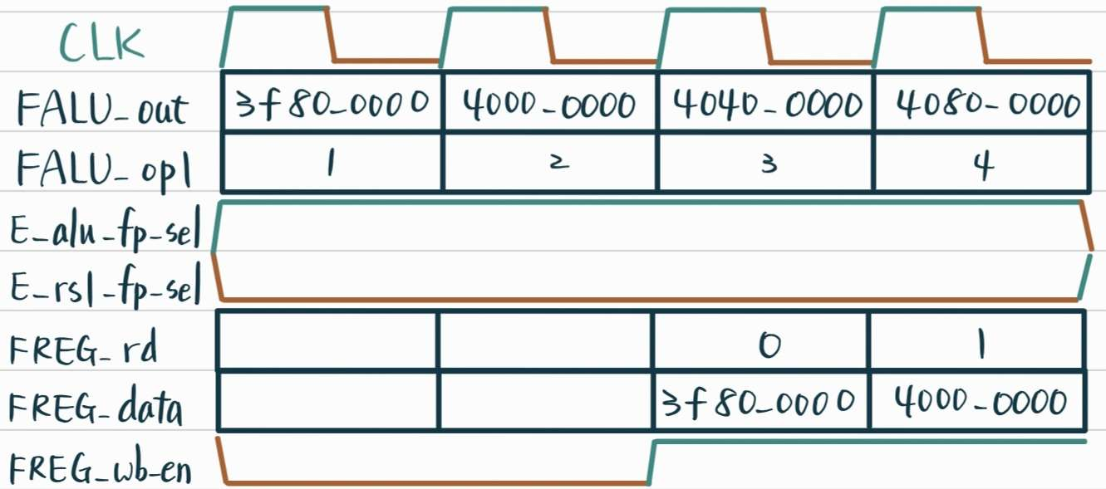
波型說明: FCVT.W.S
$$\text{+3=+1.5∗}{\text{2}}^{128−127}\text{=(0)_8’}\text{d}\text{128_(1.)100...=0}\text{x}\text{4040_0000}$$

Slide 35
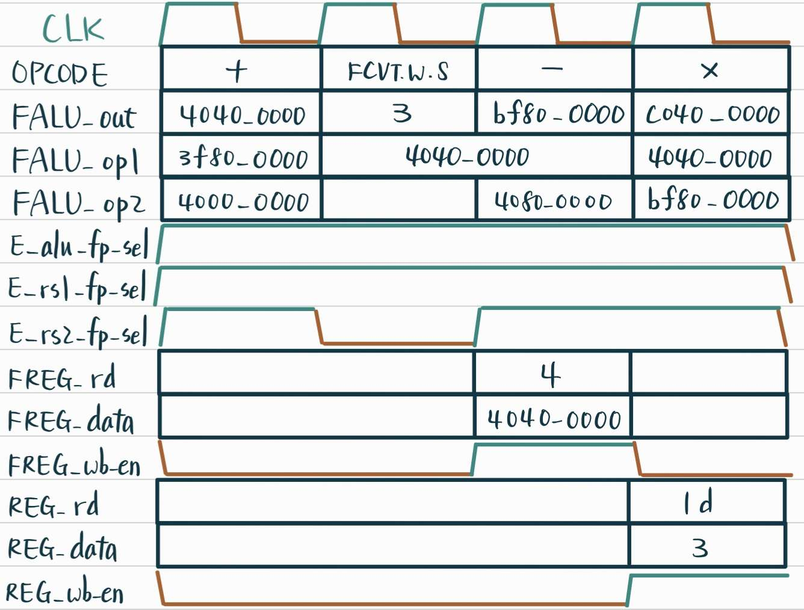
波型說明: FCVT.S.W、FADD、FSUB、FMUL

Slide 36
Accelerated Multiplier
Accelerated Multipliers Comparation

Slide 37
Verification Method
A為32bit的被乘數，B為32bit的乘數，Result為乘法結果的最後32bit。
會輸入一個clk，每過一個clk period 輸入的被乘數和乘數就會改變，而在下次被乘數或乘數改變1ns前會去驗證乘法結果是否正確，Booth’s multiplier則是多等一個cycle再去驗證。
K訊號為應該顯示的結果，p訊號為Result和K的差值，若有錯誤error訊號會變為1。
測資包括A為-128~127，B也為-128~127內的所有可能結果

Slide 38
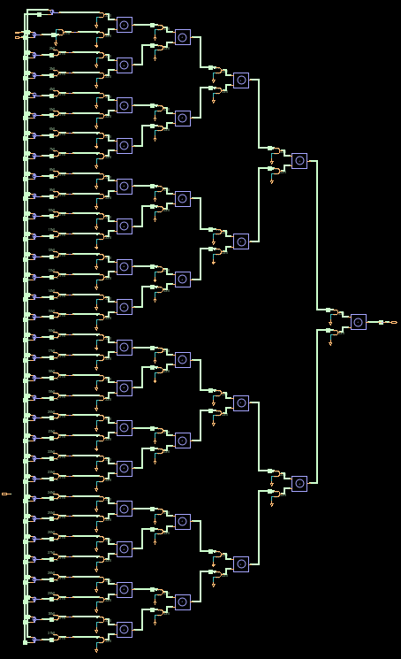
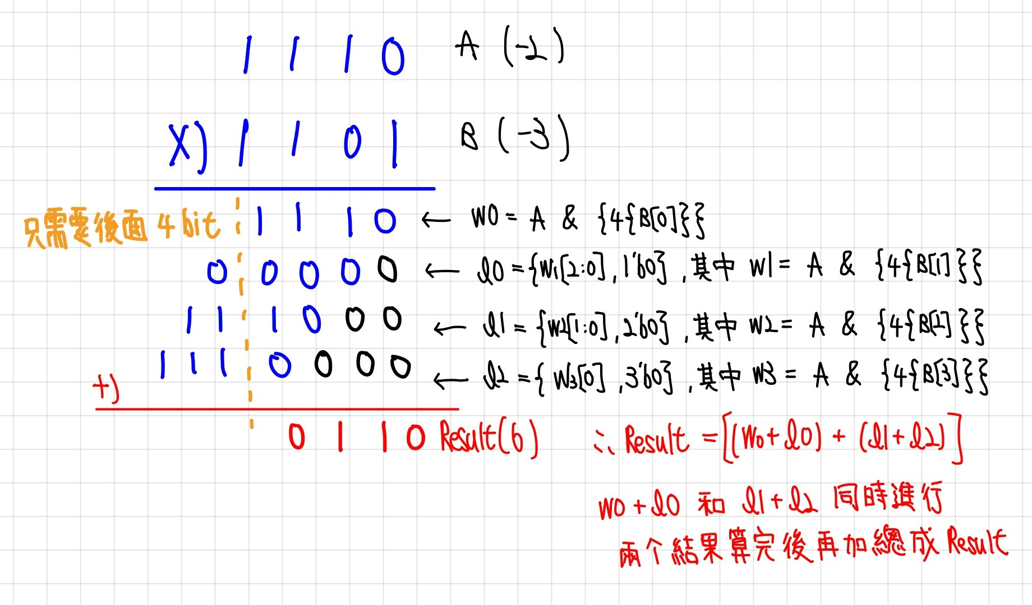
Hierarchy Multiplier

Slide 39
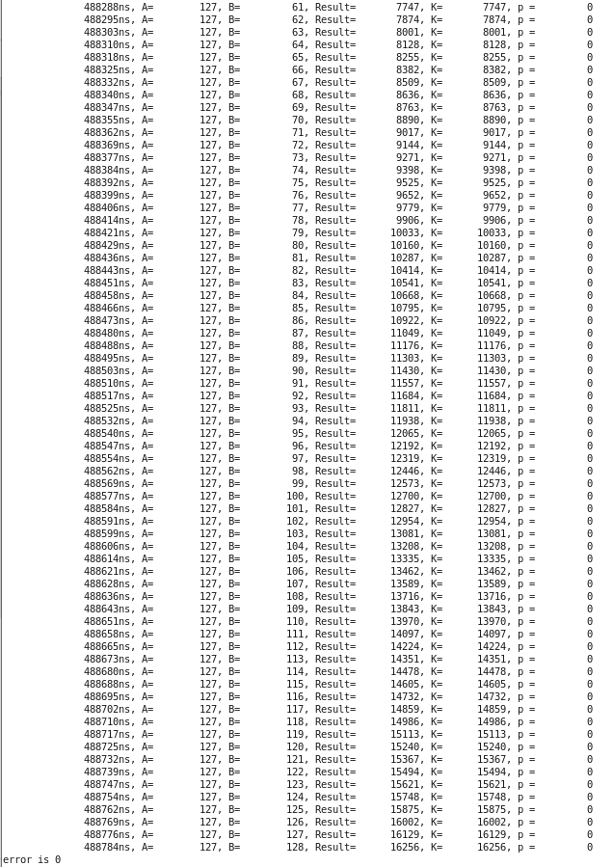
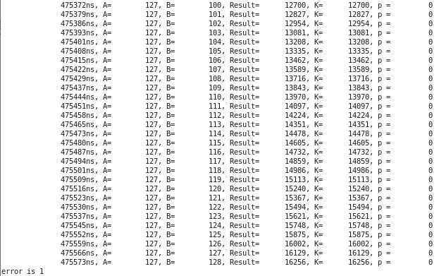
Hierarchy Multiplier - Speed
7.4 ns
7.2 ns (has error)

Slide 40
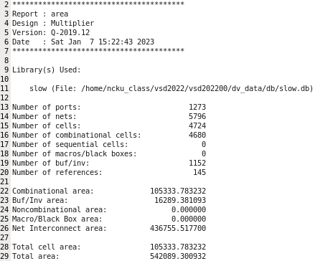
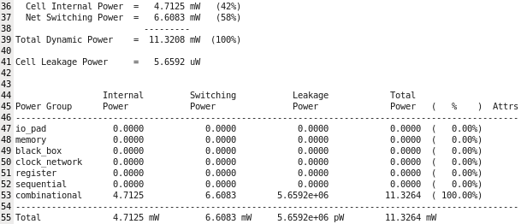


Hierarchy Multiplier – Area & Power
Total Dynamic Power：11.3208$mW$
Total Cell Area：105333.783232 $um^{2}$

Slide 41
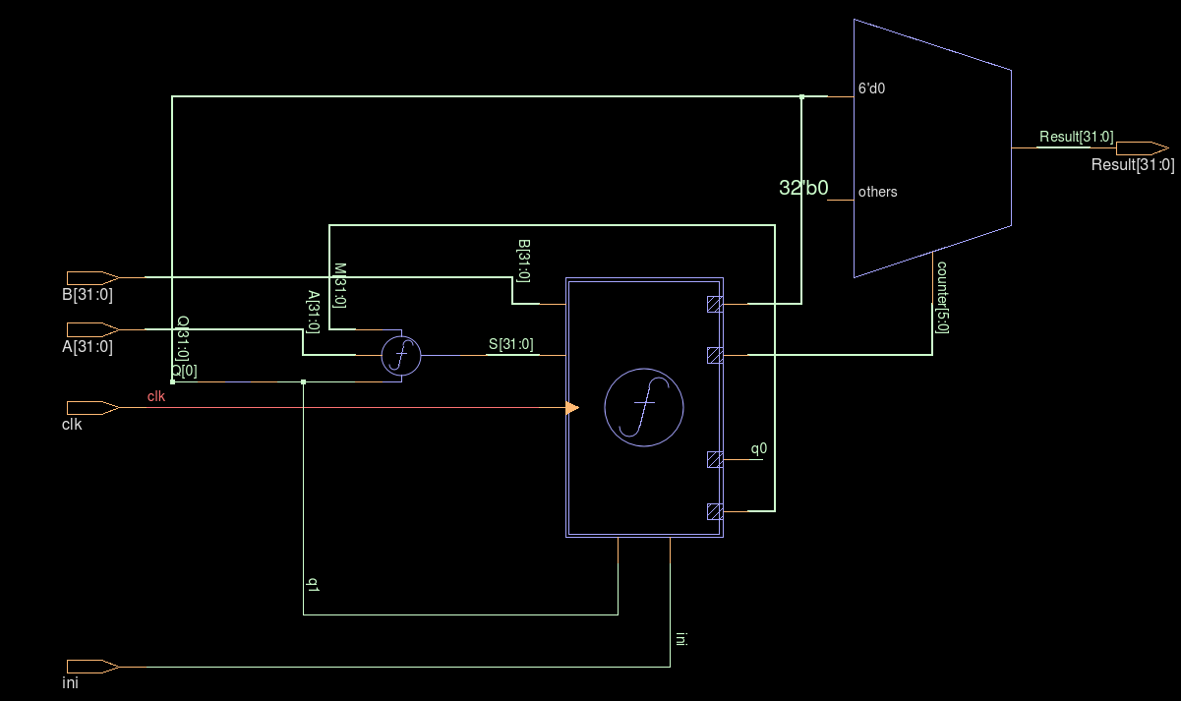
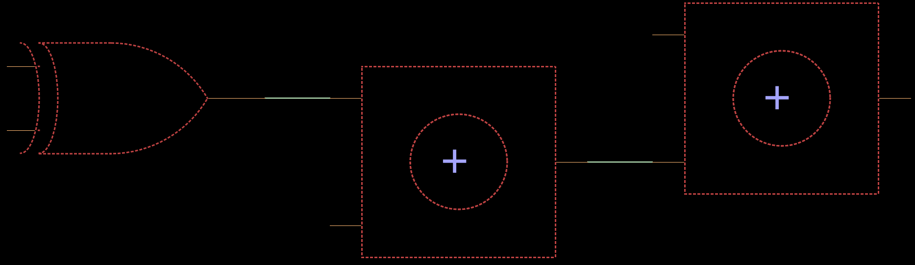
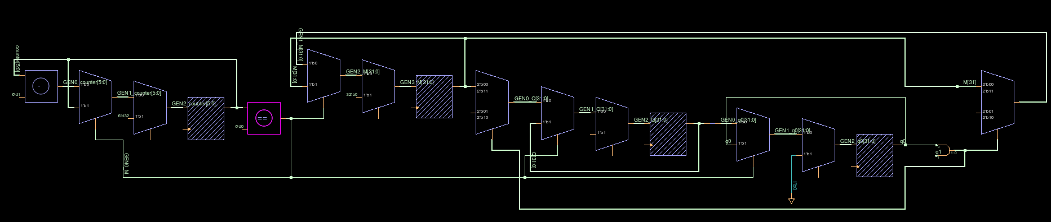
Booth’s Multiplier
Total
Little f block
Large f block

Slide 42
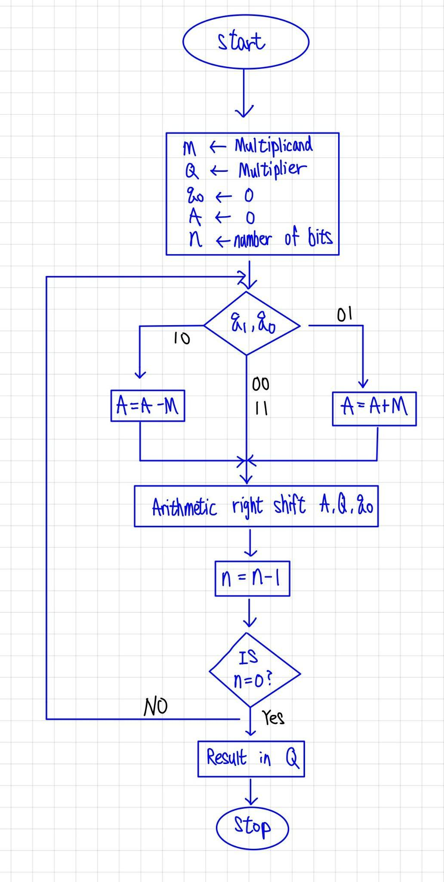
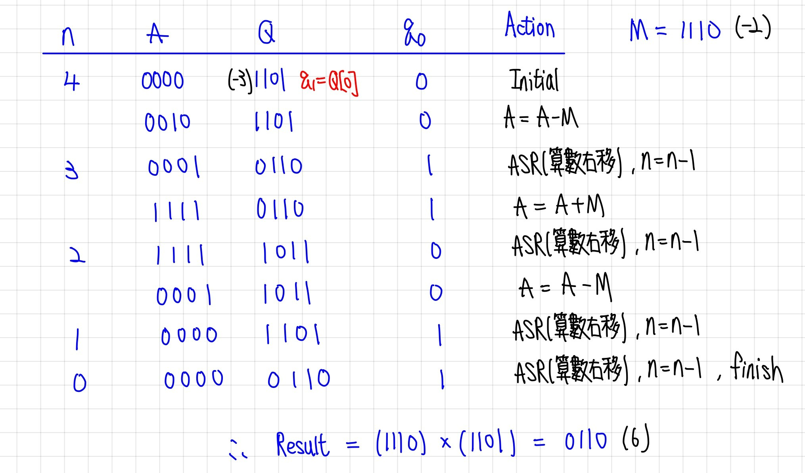
Booth’s Multiplier

Slide 43
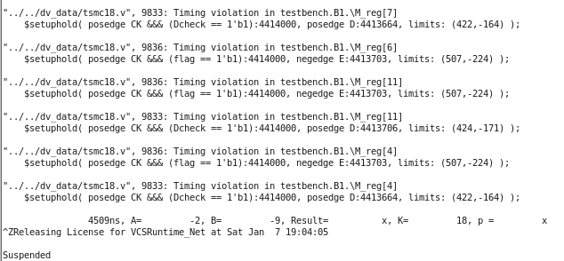
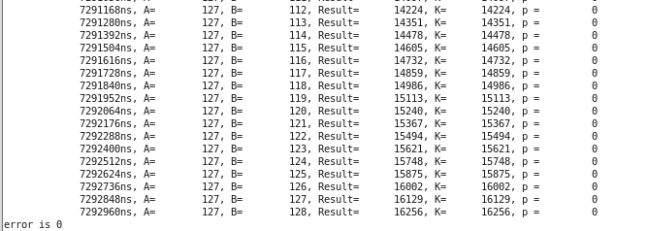
Booth’s Multiplier - Speed
3 ns (has timing violation)
3.2 ns

Slide 44
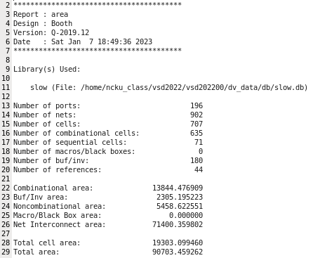
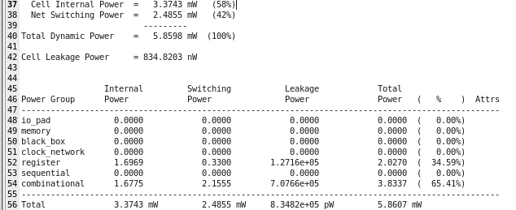


Booth’s Multiplier – Area & Power
Total Dynamic Power：5.8598$mW$
Total Cell Area：19303.099460 $um^{2}$

Slide 45
Booth’s Multiplier – Disadvantages
需要有internal clk
需要有initial訊號(在CPU內需要有判斷A和B是否穩定的訊號)
總共需要34個cycle才能算完一組乘法(要先花1個cycle reset counter，再花32個cycle運算，最後還需1個cycle穩定輸出結果)

Slide 46

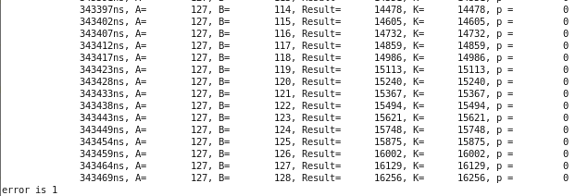

Synopsys Multiplier - Speed
5.2 ns (has error)
5.4 ns

Slide 47




Synopsys Multiplier – Area & Power
Total Dynamic Power：10.7982$mW$
Total Cell Area：57560.026422 $um^{2}$

Slide 48

Comparation
但hierarchy可以利用pipelined來處理連續的乘法
 | min period | area($um^{2}$) | power($mW$)
hierarchy | 7.4 ns (1ns hold time) | 105333.783232 | 11.3208
booth’s | 3.2 ns (need 34 cycle) | 19303.099460 | 5.8598
synopsys | 5.4 ns (1ns hold time) | 57560.026422 | 10.7982

Slide 49
Test Program Correctness
Instruction Correctness, Fibonacci Sequence, Merge Sort, Multiplication, Floating Point

Slide 50



Instruction Correctness & Merge Sort

Slide 51



Fibonacci Sequence & Multiplication & Floating Point

Slide 52
Synthesis Result
Timing, Area, Power Report

Slide 53




Synthesis Report
由於Cache採用internal clk 的設計與CPU的clk period不同因此合成時僅合成CPU的部分，Cache, Instruction Memory以及DataMemory的部分則在testbench中做接線。
Area Report:
Total cell area- 423161${um}^{2}$
Power Report:
Total Dynamic Power- 5.3572$mW$

Slide 54




Synthesis Report
以下二圖表示Max timing report (setup time), Min timing report (hold time)
Min timing Report:
Hold time slack- 0.49$ns$ > 0
Max timing Report:
Setup time slack- 0.01$ns$> 0
Clock Period: 34ns

Slide 55
Superlint
Zero Error Display

Slide 56

Superlint
No Error Message

Slide 57
ICC
Block Coverage , Expression Coverage, Toggle Coverage

Slide 58

ICC
Total Block Coverage 100%(263/268, 5 non-included statement explained below)
Total Expression Coverage 100%, Toggle Coverage 86%
僅有兩個Module Block Coverage沒有達到100% (263/268, 差5個Statement)
原因為一些無法消除的不合理Coverage Count

Slide 59



ICC
ALU Part Explanation
3個被判定為沒有Coverage到的Statement

Slide 60


ICC
Predictor Part Explanation
2個被判定為沒有Coverage到的Statement

Slide 61
EDA tools Layout
SoC Encounter

Slide 62


Layout
LVS Check
Layout Schematic

Slide 63
計畫分工表
姓名 | 學號 | 負責項目 | 貢獻度(%)
林琮偉 | E24096093 | 加速乘法器、Superlint、Word美編、整合 | 20%
林伯璨 | E24092049 | FPU、ICC、產生測資、Layout、Dataflow | 20%
吳宜哲 | E24096085 | FPU、ICC、產生測資、Layout | 20%
陳正崙 | E24096239 | Cache、PPT美編、Dataflow、合成 | 20%
張根齊 | E24096483 | CPU基本架構、ICC、產生測資 | 20%
林軒宇 | E24092057 | Branch Predict、ICC、費式數列 | (退選) >100%

Slide 64
Reference
hierarchy multiplier： 林輝堂老師計算機組織CH3講義P.30
Booth’s multiplier： Booth’s algorithm 維基百科：布斯乘法算法 - 維基百科，自由的百科全書 (wikipedia.org) Booth’s algorithm 示範影片：Booth's Algorithm for Signed Multiplication – YouTube
RISC-V 指令集架構介紹 - F Standard Extension：https://tclin914.github.io/3d45634e/
RV32F ISA：https://five-embeddev.com/riscv-isa-manual/latest/f.html
RV32F ISA Manual：https://riscv.org/wp-content/uploads/2017/05/riscv-spec-v2.2.pdf
計算機組織-Wayne講義

Slide 65

Property Include
Pipelined CPU | Branch Predict | Cache | Floating Point | Accelerated Multiplier | Pre-Simulation | (Synthesis)Post-Simulation | Superlint | ICC Coverage | Layout
✔ | ✔ | ✔ | ✔ | ✔ | ✔ | ✔ | ✔ | ✔ | ✔
Thanks for Listening

